Slide 1
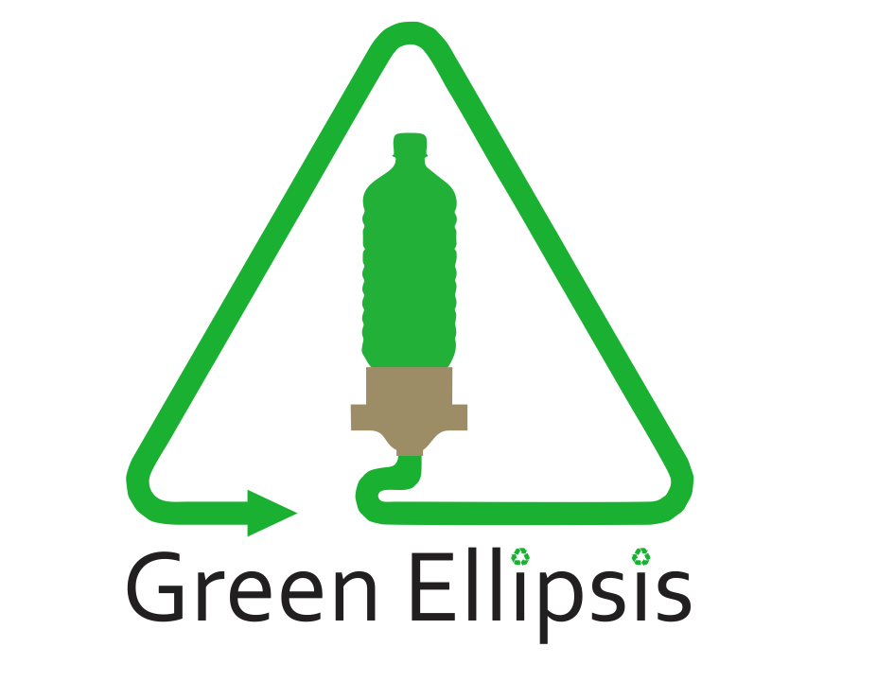
Marc Caina
Tyler Johns
Antonio Mendoza
Christian Ventouras
Nicholas Wedyck
Notes:
Marc

Slide 2
Outline
Background
Green Ellipses
Key Terms
Reclamation Process
Recreator Pultrusion
Problem Statement
Design Requirements
Design Constraints
Automation Candidates
Process Down Selection
Design Ideas
Notes:
Marc

Slide 3
Green Ellipsis Background
“Green Ellipsis Dreams of and Designs for a Sustainable Humanity”
3D-Printing - Open-source Pultrusion Community
Start-up company based out of St. Augustine
Focuses on Upcycling Two Liter PET Bottles into functioning filament
Notes:
Marc

Slide 4
Key Terms
Polyethylene Terephthalate (ter·eph·thal·ate) [PET] - Commonly used plastic
Upcycling – the process of repurposing single-use items, such as plastic bottles, to create a product of higher quality or value
Pultrusion – a process for manufacturing plastics via pulling
Notes:
Marc

Slide 5
PET Reclamation Process
Bottle Cleaning
Bottle Cutting
Filament Splicing
Filament Packaging
By-Product Processing
Strip Pultrusion
Filament Winding
Notes:
Christian

Slide 6
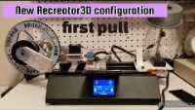
Green Ellipsis Recreator Pultruder
[1] Green Ellipsis YouTube
Notes:
Christian

Slide 7
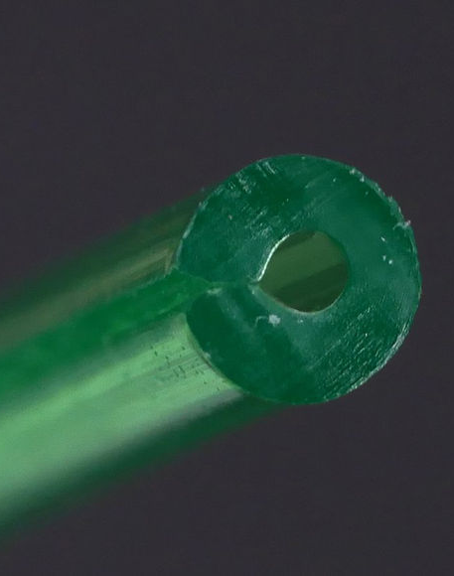
Reclaimed PET
Must be extruded at 130% flow rate
Melt temp at 225-245 ℃
Bed temp 65-85 ℃
Nozzle 0.4mm
Print Speed 30-60 mm/s
[2] rPET
Notes:
Christian

Slide 8
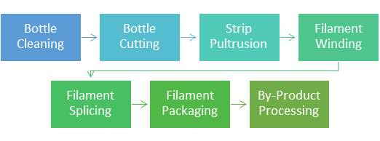
Problem Statement
Single-use PET bottles causes an abundance of pollution
Aim to upcycle bottles and convert them into 3D filament
Automation of at least one step in the Reclamation Process is required
Reclamation Processes
Notes:
Tony

Slide 9
Design Requirements
Reduce duration of reclamation process by 20 percent
Reduce human interaction by 50 percent for the bottle cutting step
Bottle cutting process must accept washed two-liter PET bottles
Must begin the pultrusion strip by cutting a 1.75mm wide ribbon from the bottle
Notes:
Tony

Slide 10
Design Constraints
Machine needs to fit in a 75cm by 240cm by 80cm volume
Must run off standard wall power (120Vac/60hz)
User must not be able to cut themselves easily
Use two-liter Pepsi product PET bottles
$1,000 budget
Notes:
Tony

Slide 11
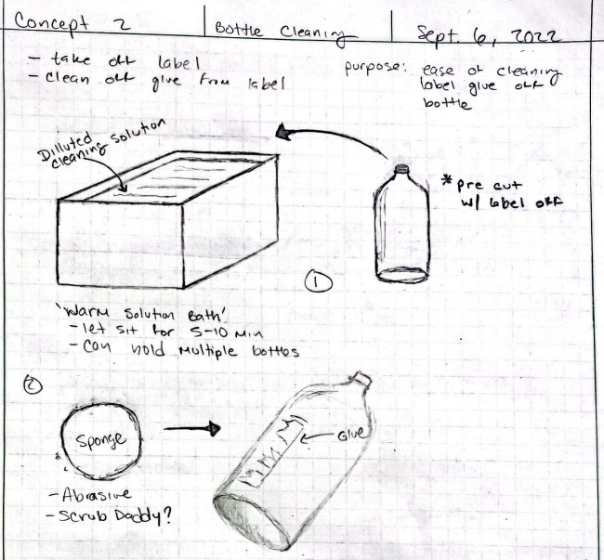
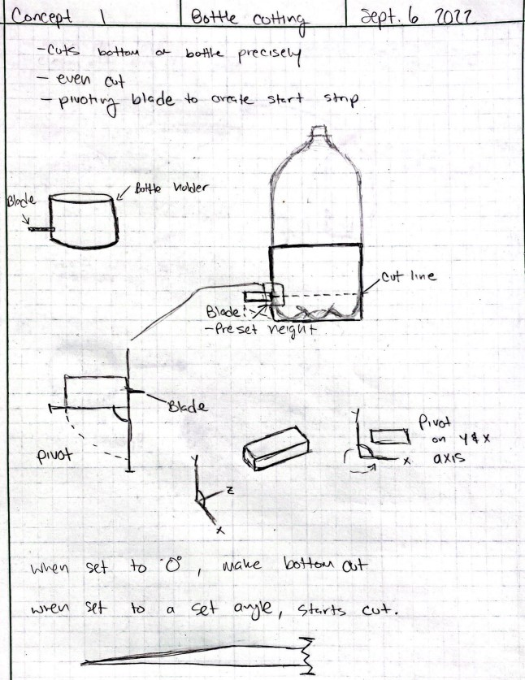
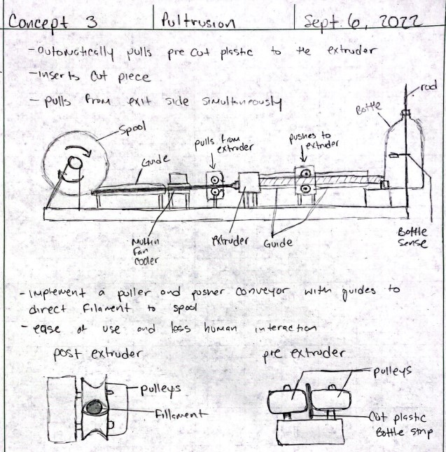
Automation Candidates
Bottle Cleaning
Bottle Cutting
Strip Pultrusion
Notes:
Nick

Slide 12
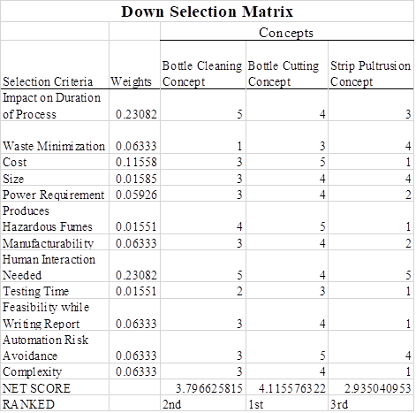
Process Down Selection
Analytical Hierarchy Process (AHP)
Normalized Weights
Five Point Scale
Notes:
Nick

Slide 13
Design Ideas – Bottle Cutting Idea 1
Similar to Current Design
Bottom Gets Cut
Blade Pivots
Strip Gets Started
Notes:
Nick

Slide 14
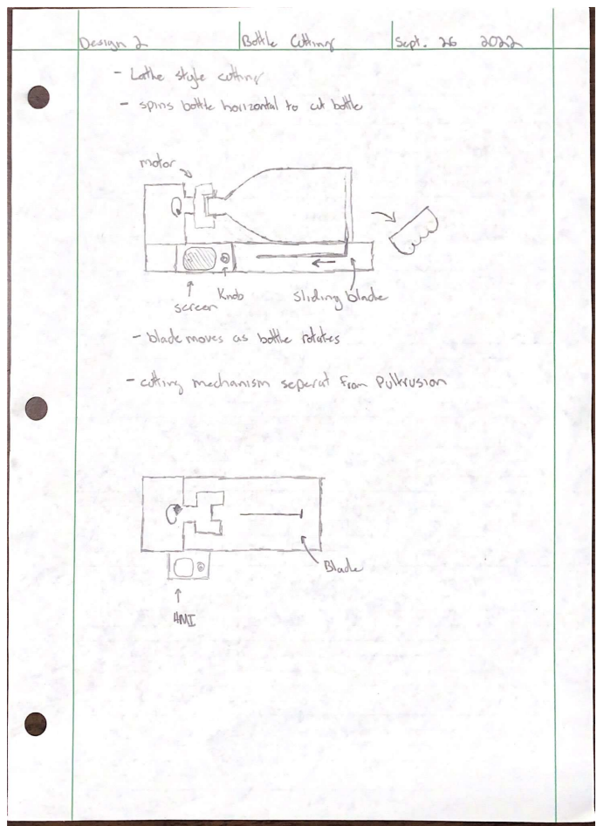
Design Ideas – Bottle Cutting Idea 2
Bottle Placed Horizontally and held by cap fixture
Bottle is rotated to make strips
Initial cut removes the bottom before blade starts moving
Blade moves as bottle rotates until a limit switch is triggered
Notes:
Tyler

Slide 15
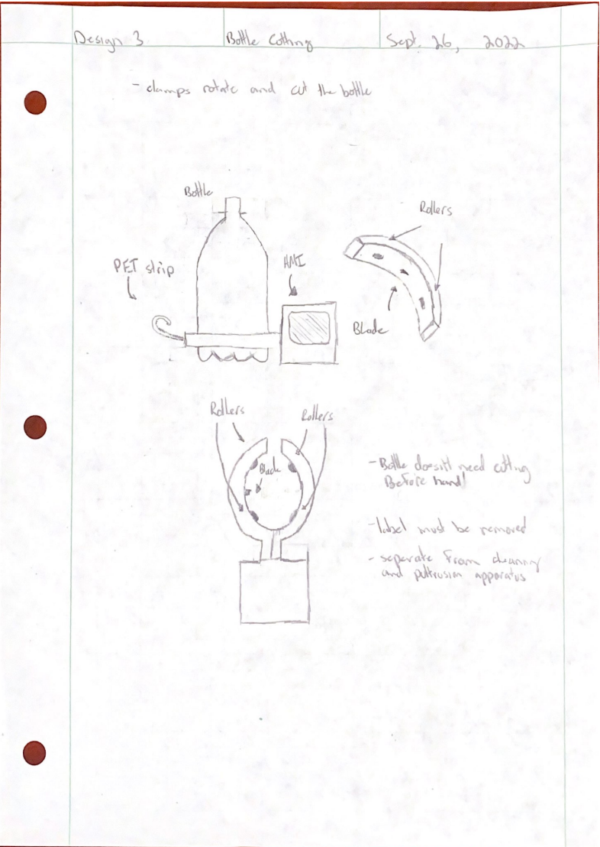
Design Ideas – Bottle Cutting Idea 3
Fixture is separate from cleaning and pultrusion steps
Clamps latch on to bottom of bottle
Rollers spin bottle while blades cut bottom off and start strip cutting
Notes:
Tyler

Slide 16

Questions?
Notes:
Tyler

Slide 17
References
[1] B. Alano, “Tension rod-less Recreator3D with runout detection,” YouTube, 12-Jul-2022. [Online]. Available: https://www.youtube.com/watch?v=w-EAWBNNP8s&amp;feature=emb_logo. [Accessed: 06-Oct-2022].
[2] RPET, “Ultrafuse® RPET - BASF Forward AM,” BASF 3D Printing Materials and Services, 18-Aug-2022. [Online]. Available: https://forward-am.com/material-portfolio/ultrafuse-filaments-for-fused-filaments-fabrication-fff/standard-filaments/ultrafuse-rpet/. [Accessed: 06-Oct-2022].

